Slide 1
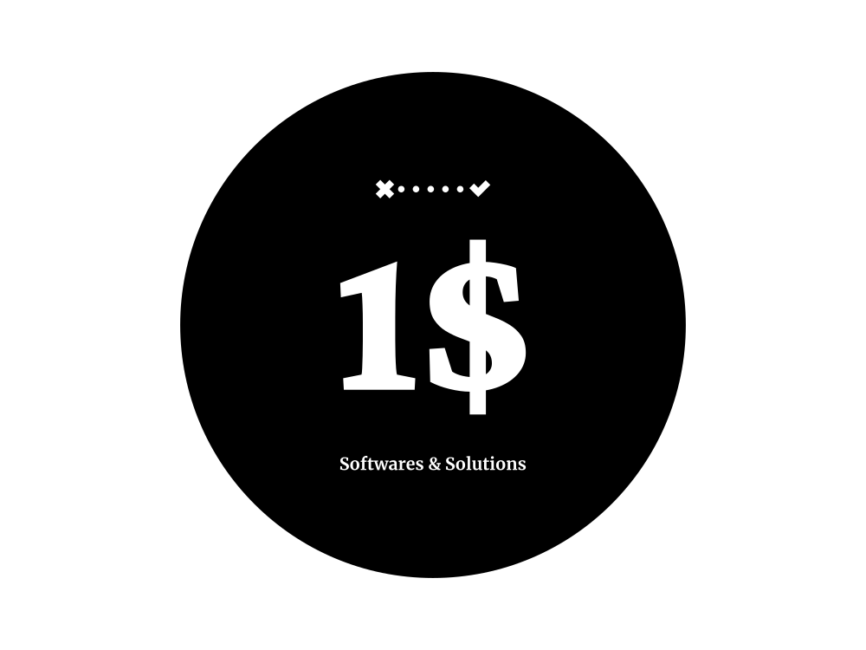

Slide 2
What is OneDollarSofts Solutions? Introduction
Platform to connect the right dots of "Requestor ⬄ Contributor" by using available best suitable technologies.
Requestor: who is in the need of non-standard or customized requirements
Contributor: who is fulfilling the work: tech-developer/support/business guy
1$ team: Does the monitoring of all and maintains transparency
We provide software products/services for only One-dollar or one-percentile of the effort (1% or 1$ whichever is max), so the name OneDollarSofts. ( By excluding additional purchases)
How the idea came: We came across many scenarios like above, we did that but stayed anonymous. Now making it official and collective in 1$.
We are not focusing on competition, instead we utilize all those existing BEST resources officially.

Slide 3
Why? – What’s the Problem
Small-Mid scale business unable to utilize the advanced technologies
Un-Affordable
Nonstandard requirement
Knowledge and Myth
Ex: Resort/Hotel in a remote place needs a google map/business profile,
Chips/Snacks makers unable to sell product to the right price (e-commerce) due to knowledge or unreachable, same applies to farmer products as well..
Technology providers unable to reach small/mid scale business
Ex: Cloud storage, AI analytics, CRM
Contributors are available but not getting the right transparent platform. Also their task completion(full or partial).
Non-standard/Customized Softwares warehouse and fulfilling

Slide 4
How Much? - Market Opportunity
2/3rd of Jobs & 40% revenue are from Small/Mid scale business.
MSME-registered companies is set to touch 63.4 million in India soon.
Globally, India ranks 3rd in the world in terms of the number of freelancers(approximately 26 million independent workers in various sectors such as IT and programming, finance, sales and marketing, designing, animation, videography, content and academic writing)

Slide 5
What Special? - Unique Approach
Understand the business requirements and fulfil with right choice with regional choice.
Ex: If cloth garments wants to share their products/designs then we will enable google map with products with Facebook business, Instagram, website up-to the need and customer level.
Being Simple & Complete Transparent in agile mode at both ends.
Most of the company give, contributors effort to paid ratio is 100:55 but we are 100:99 also removing the barrier.
Ex: If a product/service cost is 1000$ then 990$ goes straight to contributor remaining 10$ to OneDollarSofts team, in that minimum 0.1 to 1$(1-10%) to charity.
Utilizing the most of free-source/affordable across the globe by research and fitting to the customer need
No Shelve/bench/hidden/other un-related charges to customers.
Avoiding most of the barriers between requestor & contributor

Slide 6
Who all? - Team
Major guys are experienced in different technologies and domain in many MNCs across the globe.
Engaging young enthusiasts including students of cross domain
1$ Internal Team does all major validation and related activities.
Contributors: Across the world ,who has the potential to contribute.
(If they wish, will keep identity as virtual or anonymous)
Ex: Java developer working somewhere else, can contribute here for 10 hours a week. For the same work will be planned or allotted.
Someone who has social media enabling skills, will be guided through 1$ process and then will be allocated to the needy Requestor work completion.

Slide 7
What extra?
We are learning from each experiences
Instead of being restricted with formality or uniformity , we try to accommodate to the best needed way in an organized way.
We are keep researching and practising many use-cases, as soon as request comes we will accommodate with the prepared knowledge.
Based on finding will suggest technology providers for modification as necessary.
Rather considering only graduates or tech guys, empowering with real life practically experienced hands.

Slide 8
How We Drive?- Business Plan
Requirement Gathering with minimum base business[On-going]
Platform Setup[On-going]
Launching officially with Progressive validation[On-going]
Network establishing
Approaching customers with base concept and gathering
If customers accepted then progressing, otherwise gap fulfilling
Keep analysing for use-cases and be prepared with analysis[On-going]

Slide 9
With Whom? - Clients
We don’t prefer exploring the client details or our branding anywhere unless client specifically wanted. Few of there types are as below,
Schools, Colleges Educational institutions
Hardware industries and warehouses in the need of technology
Small/Mid scale business like Vehicle dealerships, Showrooms, Hospitals , Network, Hotels, Cloth shops, Snacks makers
Technology providers like Google, Microsoft, Amazon, Facebook, Xencia
Contributors also can be clients, as per their needs or query addressing like technical clarifications.

Slide 10
What Technology and Providers?
Since we are in wide spectrum and we are not restricted with any boundary. If request comes and if we have the capacity will achieve otherwise clear answer is NO with smile or possible alternative. Immediately will start preparation for missing part.
Few are
Microsoft(Azure & devops), Google(*), Amazon(aws) all with cloud techs
Website and web application development
Legacy tech stack handling and possible replacements

Slide 11
Where we are?
Ideation- Mostly Completed[80%]
Validation-On-going[60%]
Internal Team Expansion- Searching[30%]
Playground Platform Identification & Setup- Azure & Aws [20%]
System/Platform Readiness- On-going [18%]
Interacting with possible business and QA- On-going […]
Registered in the year 2022-23 at Karnataka,India as LLP[before Feb-23]
Officially launching to public – Targeting by March-23
Globally expanding-Not yet
In-house development team expanding for more research-Not yet

Slide 12
Where are clients located?
Not restricted to any specific area.
As the requirement comes, will try to remotely handle
If necessary physically meeting or will assign the nearest contributor
Current clients are mostly from South-India, Srilanka-Jaffna province

Slide 14
How Much? - Financials
Currently to avoid the conflicts in idea and execution, its completely self bootstrapped .
We are supported by Microsoft Growth. Thanks …

Slide 15
What Later? - Expansion Plans
Business analysis in broad spectrum
In-house products sales at Marketplace
Small/Mid scales business connector hub
Social impacting platforms like women safety, human trafficking
Charity work either direct or helping other big hands like Infosys, Wipro, Melinda-Gates foundations, Red-cross, Rotary

Slide 16
Call To Action=>
We prefer the quality rather than number of clients or contributors or case completion.
“If you’re good at something, never do it for free.” ― The Joker
“The best things in life are free” -Luther Vandross
So we are helping to identify the best or something new at best value.
Browse across our portal(not-yet ready ;)) and Place your request, if satisfied with estimation and plan then proceed otherwise leave your feedback, it helps further for improvement.

Slide 17
Thanks… Lets join with real scenarios… SUGGESTIONS & CONTRIBUTIONS ARE MOST WELCOME
You can Contact us at https://wa.me/9482696525 (WhatsApp or email is preferred)
Onedollar.softwares.solutions@outlook.com

